Slide 1
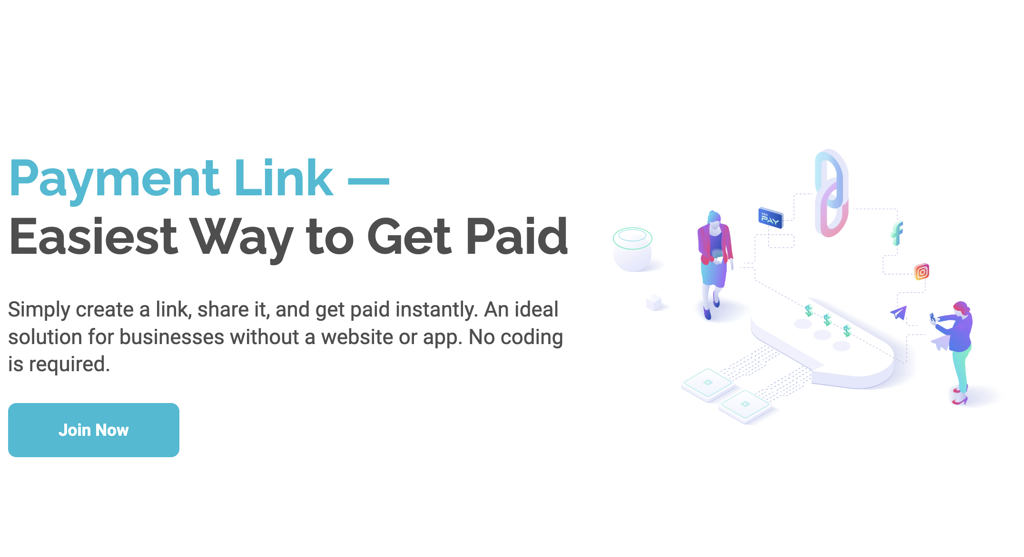
ABA Payway Integration

Slide 2




Slide 3



Goal
Create order
Initiate payment
Display QR

Slide 4
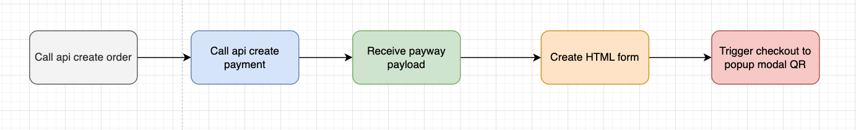
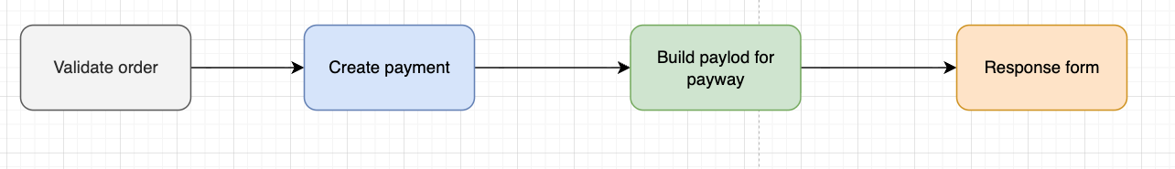
Overall flow
Frontend flow
Backend flow

Slide 5

Common Issues
Wrong hash order
Missing fields
Popup not rendering
403 after success (UI issue)
Domain not whitelisted

Slide 6

Best Practice
Keep logic in backend
Verify payment after success
Log payload + hash

Slide 7
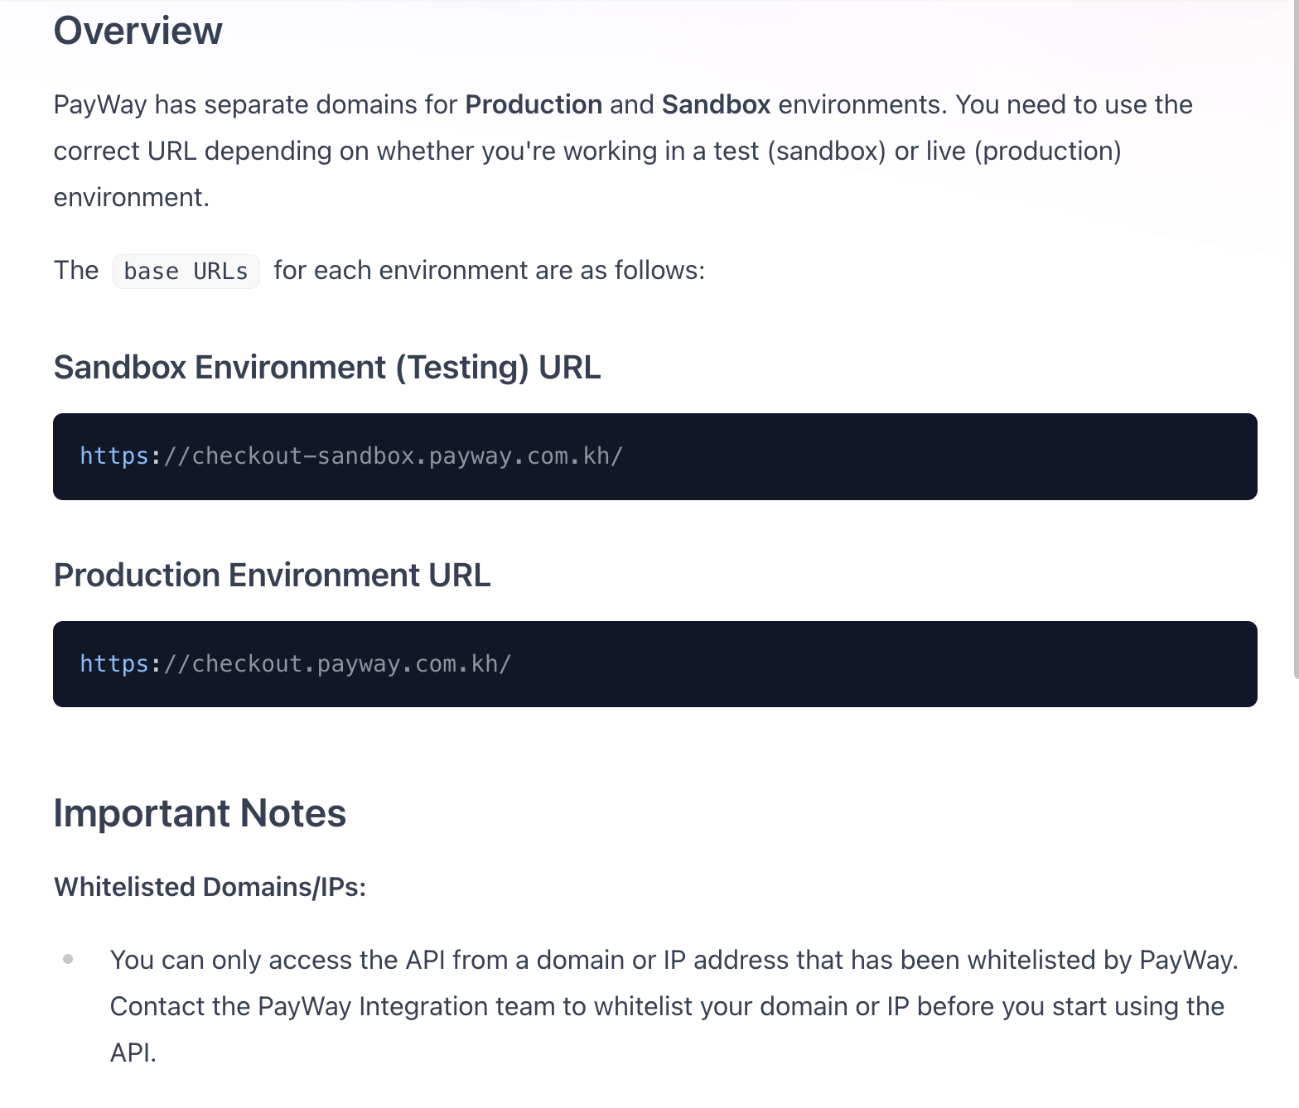
Environment

Slide 8
Reference
https://developer.payway.com.kh

Slide 9


